Slide 1
TITLE : IoT Based Wireless Smart Board
Under the Guidance of:
Department of ISE
Acharya Institute Of Technology
Project Team Members:
Batch No: 5
Pravesh Kasaundhan (1AY15IS072)
1

Slide 2
Agenda
2
Abstract
Introduction
Problem Statement
Proposed System
High Level Design
Low Level Design

Slide 3
Abstract
3
Digital display board is a common sight today. Advertisement is going digital in recent days. The use of digital display boards at railway station, bus stands, educational institutions and public places are becoming an effective mode of communication in providing information to the people.
If the user wants to change the message it needs to be done using a computer and hence the person needs to be present at the location. Also the display board cannot be placed anywhere because of complex and delicate wiring. Digital smart board overcomes these drawbacks.

Slide 4
Introduction
4
Digital smart board is an automatic self enabled, highly reliable wireless electronic board.
The information can be text, images, audio and video.
It makes use of a mini computer, which is commonly termed as Raspberry Pi.
It aims at designing a LED Monitor based message display controlled through a laptop.

Slide 5
Contd…
5
A display connected to a server system should continuously listen for the incoming messages from user, process it and display it on LCD screen.
Message displayed will be updated every time the user sends new information.
Only authenticated people will be able to update the data to be displayed on the monitor.
The main objective is to design an automatic, self-enabled highly reliable electronic notice board.

Slide 6
Existing System
Drawbacks
The developers have used old technology, like GSM, which had low range and bandwidth.
Transmitter/receiver technology used C language in Keil Software. This system used old techniques to transmit information which was not economic.
These technologies are inefficient and not reliable.

Slide 7
Problem statement
To overcome the drawbacks of the existing system, we are proposing modern technologies such as IOT with wireless based remote access network.

Slide 8
Proposed System
This project, aims to increase the usability of electronic notice boards, deals with wireless reception and display of messages using Raspberry pi. Practically, all output resolutions are supported. It aims at designing a LED Monitor based message display controlled through a laptop. It is simple, easy to install, user-friendly system which can receive and display information in a particular manner with respect to date and time which will help the user to easily keep the track of information every day and each time he uses the system.

Slide 9
High Level Design
9tttt
List of Modules Identified
Module 1: Configuration
Module 2: Setup
Module 3: Assembly
Module 4: Deployment

Slide 10
Module 1: Configuration
Objective: In this module , we will be configuring Raspberry Pi , Router and Dataplicity.
Methodology:
Using Python: The python library will be used to configure the Raspberry Pi. The python libraries such as numpy ,pandas, requests will be used to write the python scripts.

Slide 11
Module 2: Setup
Objectives: In this module, we will be setting up the environment for the next phase.
Methodology:
This phase involves the following method:
Getting the digital board ready by providing the power supply and connecting it to the network.
Install Raspbian OS on raspberry pi and set it ready for use.
Register yourself and the device online with Dataplicity.

Slide 12
Module 3: Assembly
Objectives: In this module, we will be assembling all the components configured and set in the previous phase.
Methodology:
Connect the laptop to internet either through Wi-Fi/LAN.
The Raspberry Pi will be connected to the same network as your laptop through the wi-fi adapter present in Raspberry Pi.
The raspberry Pi will be connected through the HDMI port to the Digital screen.

Slide 13
Module 4: Deployment
Objective: In this module, we will be deploying the system.
Methodology:
The user will push the information or data to be displayed through the Dataplicity portal.
This information through the internet will be sent to the raspberry pi which is present in the remote location.
The raspberry pi will push the same data onto the smart board which will display this data.

Slide 14
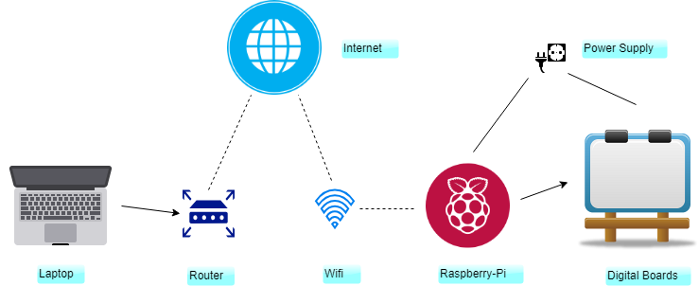
System Diagram

Slide 15
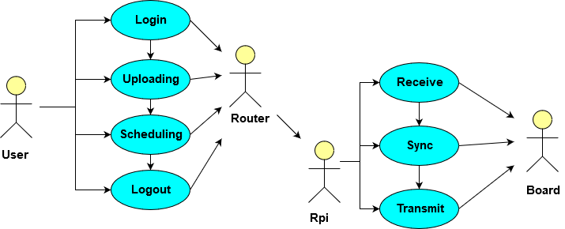
Low Level Design
Use Case Diagram

Slide 16
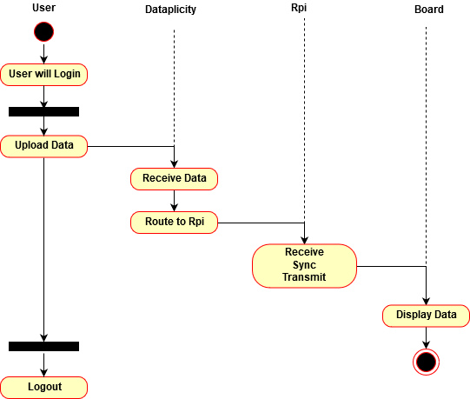
Activity Diagram
16

Slide 17
Gantt Chart

